Slide 1
Taxonomy, Part 1
Source of most materials:
Xiwei Xu, Ingo Weber, and Mark Staples. Architecture for Blockchain Applications. Springer, 2019

Slide 2
What will you learn?
Definition of a taxonomy
Blockchain taxonomy
(De)centralization
Deployment
Ledger Structure
Consensus Protocol
Block Configuration and Data Structure
Auxiliary Blockchain
Anonymity
Incentive System

Slide 3
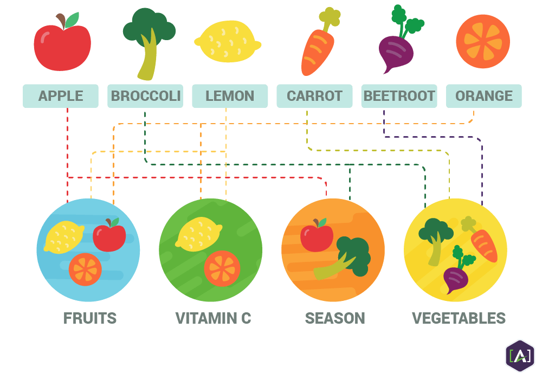
What is Taxonomy?
Taxonomy is the practice and science of classification of things or concepts, including the principles that underlie such classification.
Notes:
Taxonomy definition
Fruit/Vegetable: Based on botanical characteristics
Fruit is a seed-bearing structure develops from ovary of flowering-plant.
Vegetables are all other plant parts, like roots, leaves and stems
Vitamin C: Content of Vitamin C
Season: Time they grown and harvested

Slide 4
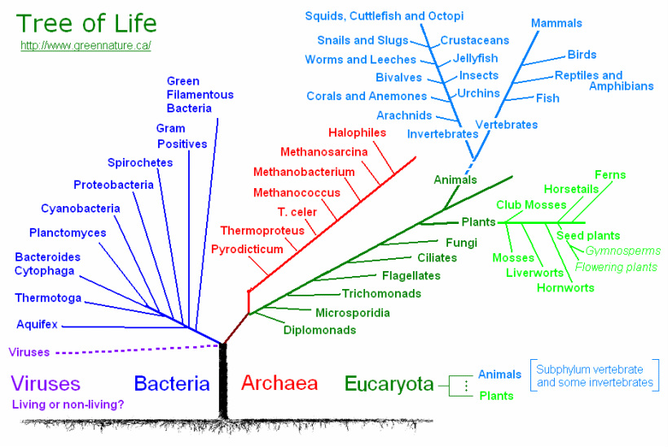
What is Taxonomy
Notes:
More complex biology taxonomy
Placing the known plants and animal into groups or categories to show some relationship
Follows a system of rules that standardizes the results
Groups successive categories into a hierarchy
Eucaryota includes animals and plants
Animals are divided into invertebrates (Wirbelos), including jellyfish, snails slugs, Vertebrates (Wirbeltiere) includes mammals, birds etc.

Slide 5
Why Taxonomy?
Diverse range of blockchain has emerged since the advent of Bitcoin in 2008
Complex internal structure and many configurations and variants
Comparison of different blockchain is difficult
Lack of product data and technology evaluation resources
Blockchain Taxonomy
Dimensions and categories for classifying blockchains
Understanding blockchain technology
Benefits
Systematically consider the features and configurations of blockchain
Explore the conceptual design space
Compare and evaluate design options
Assess their impact on quality attributes
Notes:
Building application on blockchain need to consider features and configuration
Assess impact on quality attributes for the overall system
Early stage with little product data or reliable technology evaluation available to compare different variant
Presenting taxonomy defines dimensions and categories for classifying blockchains and ways of using them in systems.
Taxonomies have been used in software architecture to understand existing technologies.
Our taxonomy captures major architecturally-relevant characteristics of various blockchains, and indicates their support for various quality attributes.
Performance and quality attributes of blockchain-based systems, as well as core concerns of blockchains like decentralization and the data structure used.
The taxonomy is informed by existing industrial products, technical forums, academic literature, and our own experience of using blockchains and developing prototypes.

Slide 6
Properties of Blockchain
Blockchain cannot meet requirements for all usage scenarios
E.g. those that require real-time processing
Fundamental Properties
Immutability from committed transaction
Integrity from cryptographic tool
Transparency from public access
Equal rights from consensus
Weighted by the compute power or stake owned by the miner
Limitation
Data privacy
No privileged users
Scalability
Size of the data on blockchain
Transaction processing rate
Latency of data transmission
Notes:
From software architecture perspective, blockchain is a distributed database with unique properties and limitations.
Cannot meet requirements for all usage scenarios
Data privacy and scalability are the two limitations of public blockchains.
On a public blockchain, there is no privileged users, and every participant can join the network to access all the information on blockchain and can validate new transactions.
the mainstream public blockchain can only handle on average 3-20 transactions per second
mainstream payment services, like VISA, can handle an average of 1,700 transactions per second.

Slide 7
Taxonomy: A Glimpse 1/2 (recap)
Classification
 | Permission-less | Permissioned
Public | Consensus: Proof-of-X Permission management Blockchain layer Application layer (optional) Incentive: Blockchain layer | Consensus Proof-of-X PBFT, Federated consensus, Round Robin etc. Permission management Blockchain layer Application layer (optional) Incentive: Blockchain layer Governance around permissions
Private | Consensus Proof-of-X PBFT, Federated consensus, Round Robin etc. Permission management: Blockchain layer Network layer Application layer (optional) Incentive: Governance around access | Consensus Proof-of-X PBFT , Federated consensus, Round Robin etc. Permission management: Blockchain layer Network layer Application layer (optional) Incentive: Governance around access permissions
Notes:
2 by 2 Matrix gives a simple taxonomy
4 categories based on 2 dimensions: public/private and permissioned/permission-less
Compared based on 3 aspects, including consensus protocol, permission management and incentive
Permission-less public (bitcoin/ethreum) -> permissioned private → Permissioned Public (Ripple) → Permission-less private (rare)
Incentive in permission-less public: transaction fee and block reward
In federated consensus protocol, blocks are considered accepted once they have been signed by a specified quorum of block signers. This is implemented using a consensus program that checks an “M-of-N multi-signature
PBFT: Practical byzantine fault tolerant

Slide 8
Taxonomy: A Glimpse 2/2 (recap)
Quality Tradeoffs
 | Permission-less |  | Permissioned
Public | Immutability Integrity Transparency Availability Performance Cost Efficiency | +++ (#Nodes, Consensus, Topology) +++ (#Nodes, Consensus, Topology) ++ (Access control) +++ (#Nodes, Topology) + (Consensus, latency) + | Immutability Integrity Transparency Availability Performance Cost Efficiency | ++ ++ ++ ++ ++ ++
Private | Immutability Integrity Transparency Availability Performance Cost Efficiency | + + + + +++ +++ | Immutability Integrity Transparency Availability Performance Cost Efficiency | + + + + +++ +++
Notes:
Matrix shows the impact on quality attributes.
Number of plus represent the extent of the quality. How bad and how well the quality is compared with other alternatives.
Aspects in brackets can effect the quality
Permission-less public blockchain has the best immutability, but worst performance and cost efficiency
Performance is worse due to latency caused by consensus on a big network

Slide 9
Taxonomy Dimensions
(De)centralization
Deployment
Ledger Structure
Consensus Protocol
Block Configuration and Data Structure
Auxiliary Blockchain
Anonymity
Incentive System
Notes:
8 dimensions to classify blockchain variants

Slide 10
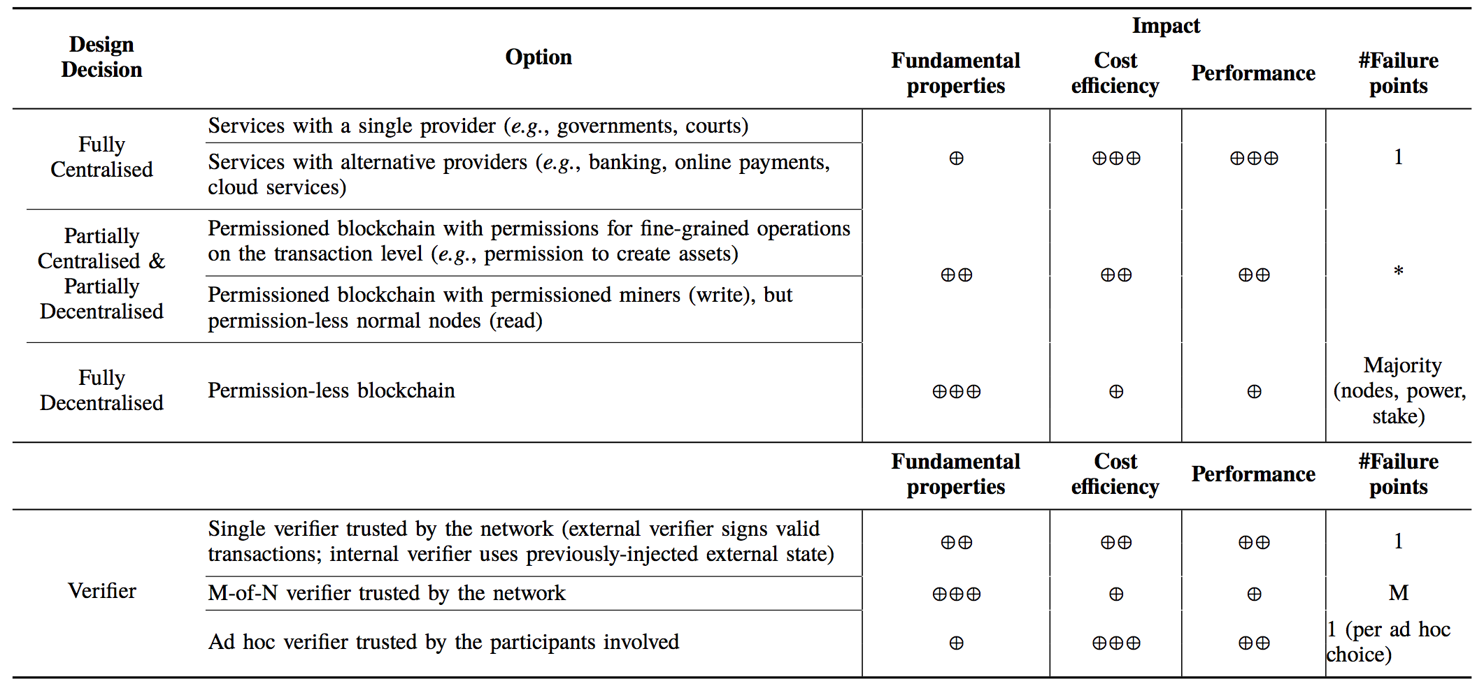





Centralization – Decentralization
Notes:
Decentralisation is one of the distinguishing capabilities of blockchain technology.
Decentralisation devolves responsibility and capability from a central location or authority.
In a centralised system, all users rely on a central authority to mediate transactions.
For example in a bank, customers rely on the bank’s systems to correctly adjust their account balances after a bank transfer.
Manipulate the whole system: updating backend databases, or upgrading the software
A single point of failure for the whole system → avoided through geographical replication.
Government, courts
a fully decentralised currency allows people to reach agreement on who owns what without having to trust each other or a separate third party
Highly available since every full node in Bitcoin has a full copy of the blockchain, processes every transaction.
There are currently more than 9000 nodes in the Bitcoin network
There is a spectrum of possibilities between centralisation and decentralisation.

Slide 11
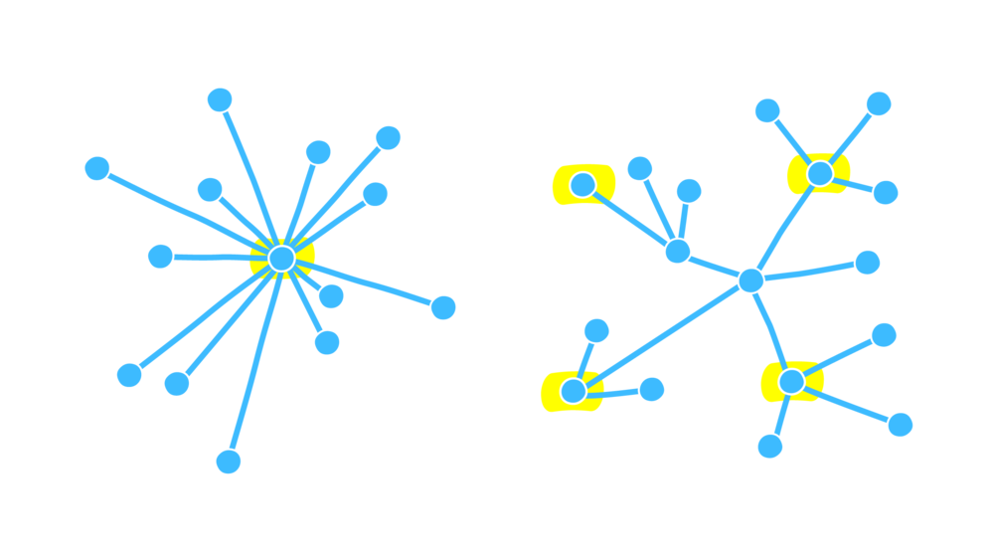
Full Centralization
Services with a single provider
E.g., government agencies, courts, business monopolies
Single point of failure
Services with alternative providers
E.g., banking, online payments, cloud services
Failure of a single service provider affects its users – also for business failures
E.g., when a company behind IoT devices goes bankrupt and switches off the servers, and devices stop working
Notes:
Monopoly service provider, including governments and courts within a jurisdiction, and business monopolies.
Competing alternative providers, such as banks, on-line payments, or cloud computing providers
Single point of failure for its users.
Failure of a single service provider only affects its users.
Users may switch providers, or may be able to use multiple providers.

Slide 12
Full Decentralization
Permission-less public blockchains
Completely open
New users can join, validate transaction, and (try to) mine blocks at any time
Protection against Sybil attacks by ignoring identity of nodes
PoW: the total amount of computational power, not the number of nodes, is important for integrity
Notes:
Bitcoin and Ethereum. Permission-less public blockchains are completely open: new users can at any time join the network, validate transactions, and mine blocks.
Decentralised systems using anonymous validators to protect against Sybil attacks, where attackers create many hostile anonymous nodes.
Bitcoin’s proof-of-work mechanism: it is not the total number of nodes that is important for integrity, but rather the total amount of computational power.
A decentralised system can be defeated if there is a majority of authority (nodes, computational power, or stakeholding).
Game-theoretic attacks can change this threshold, requiring a higher (e.g. 66%) majority to maintain integrity.

Slide 13
Partial (De)centralization 1/2
Permissioned blockchain requiring authorities to act as a gate for participation
Permission to join the network (read)
Permission to initiate transaction (write)
Permission to mine / create blocks / contribute to consensus
Permissioned blockchain with permissions for fine-grained operations
Permission to create assets
Permissioned blockchain with permissioned miners (write), and permission-less normal nodes (read)
New users can join, validate transaction or mine block at any time
Notes:
a blockchain may be permissioned in requiring that one or more authorities act as a gate for participation.
The client programs from public blockchains can also be deployed on private networks to create a kind of permissioned blockchain using network access controls.
Permission information can be stored either on-chain or off-chain.

Slide 14
Partial (De)centralization 2/2
More suitable in regulated industries
Banks establish the real-world identity of transacting parties
Know-Your-Customer (KYC) regulation
Transactions on permission-less blockchain
Across jurisdictional boundaries
Undermine regulatory controls
Better control access to off-chain information about real-world assets
Tradeoffs between permissioned and permission-less blockchains
Transaction processing rate, cost, censorship-resistance, reversibility,
finality and flexibility in changing the network rules

Slide 15
Taxonomy Dimensions
(De)centralization
Deployment
Ledger Structure
Consensus Protocol
Block Configuration and Data Structure
Auxiliary Blockchain
Anonymity
Incentive System
Notes:
8 dimensions to classify blockchain variants

Slide 16
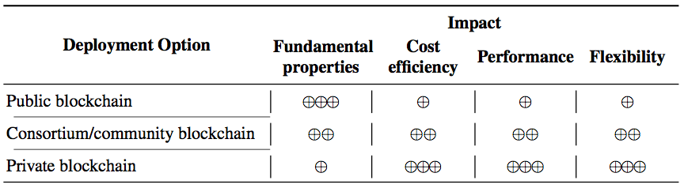
Deployment
Public blockchain: Most cryptocurrencies
Anyone on the internet can access
Better information transparency and auditability
Sacrifices performance and has different cost model
Data privacy relies on encryption or cryptographic hashes
Notes:
Three deployment types
Public blockchain

Slide 17
Deployment
Consortium/private instantiation of public blockchain
Blockchain platform is open source
Network layer access control – firewall
Consortium/Community blockchain
Across multiple organizations
Consensus process is controlled by pre- authorized nodes
Read permission can be public or restricted to specific participants
Private blockchain
Write permission kept within one organization
Governed and hosted by a single organization – most flexible
Notes:
Consortium/community Blockchain
Private blockchain
include multiple divisions of a single organization
Most flexible for configuration

Slide 18



Student Task
Try to find an example for using each deployment option, i.e., one each for
Public blockchain
Consortium blockchain
Private blockchain
After 2 minutes, we will discuss your examples

Slide 19
Taxonomy Dimensions
(De)centralization
Deployment
Ledger Structure
Consensus Protocol
Block Configuration and Data Structure
Auxiliary Blockchain
Anonymity
Incentive System
Notes:
8 dimensions to classify blockchain variants

Slide 20
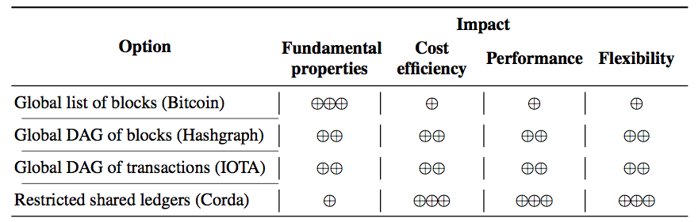
List
Global list of block
Bitcoin/Ethereum
Nodes record blockchain as tree of blocks
Shorter branches attached to the main chain represent alternative competing histories
Only transactions on the main chain (list) are considered part of the ledger
Used for operating blockchain and determining consensus
→ Blockchain is a list of blocks under the logical view from a user’s perspective
Notes:
BitcoinIn Bitcoin, the history of all transactions is captured in the blockchain structure
Bitcoin nodes actually record the blockchain as a tree of blocks
Under the logical view from a user’s perspective, the blockchain is a list of blocks.

Slide 21

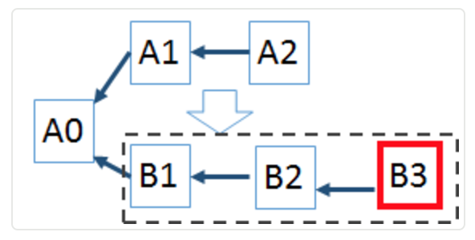
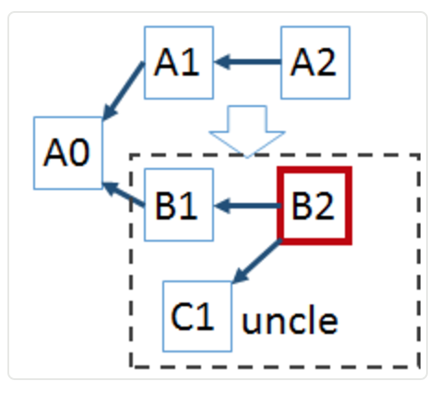
Tree
Bitcoin
Block interval time: 10 minutes
Block propagation (50% of the network): ~12 s
Orphan/uncle/stale blocks
Two nodes find a block at same time
Propagated, verified, but eventually being cast off
Content “forgotten”, i.e., transactions in stale blocks “have not happened”
Shorter inter-block time suffer from a higher number of stale blocks
Ghost (Greedy Heaviest-Observed Sub-Tree)
Add stale blocks (uncles) into calculation of cumulative difficulty
^{Bitcoin}
^{Ethereum}
^{Longest chain}
^{Heaviest tree}
Notes:
LONG
An orphan, or stale block, is created when two nodes find a block at the same time
Both say we’ve found the solution to this block and send off their block to be verified and included in others block chains
But eventually being cast off as a longer chain achieved dominance, or Forking.
In Bitcoin, the probability of finding a block at the same time is relatively low when the block time is ten minutes and propagating a block to 50% of the network takes roughly 13-15 seconds on average.
Ethereum miners reference competing independently-mined blocks (uncle blocks), to add weight to their chain for its selection as the main chain.
This recognition of concurrent work allows shorter inter-block times which can improve throughput.

Slide 22
Graph: Global DAG of Blocks
Global directed acyclic graph (DAG) of blocks
Hashgraph
Logical view of transactions is based on a DAG of blocks
Rather than a list
Notes:
https://www.youtube.com/watch?v=IjQkag6VOo0

Slide 23
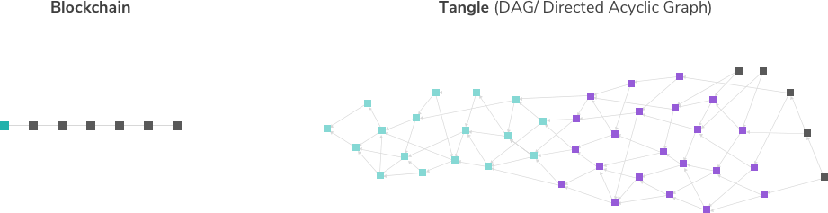
Graph: Global DAG of Transactions
 | Blockchain (Bitcoin) | IoTA
Byzantine Fault Tolerance limit | 51% (precisely: 50% -1; actually: lower) | 33 1/3 %
Confirmation Time | ~60 min (6-Confirmation) | Unstable
Notes:
IOTA a Directed Acyclic Graph (DAG) implement in distributed ledgers
IOTA does not have the mining mechanism or hold periodical competitions. the actions are asynchronous.
In order to participate in this network, a participant simply needs to perform a small amount of computational work that verifies two previous transactions.
In order to make a transaction in the Tangle, two previous transactions must be validated
The reward for doing so being the validation of your own transaction by some subsequent transactions
To finally accept a transaction in IOTA requires an accumulation of a number of later transactions points to it, thus the speed is largely dependent on how active the network is
IOTA is more vulnerable to 34% power attacks.
.

Slide 24
Tradeoff Overview
Single global transaction history
Multiple small ledgers
Multiple small ledgers shared between parties of interest
Hyperledger Fabric, Corda
Parties of interest are authorized to view the transactions recorded in specific ledgers

Slide 25
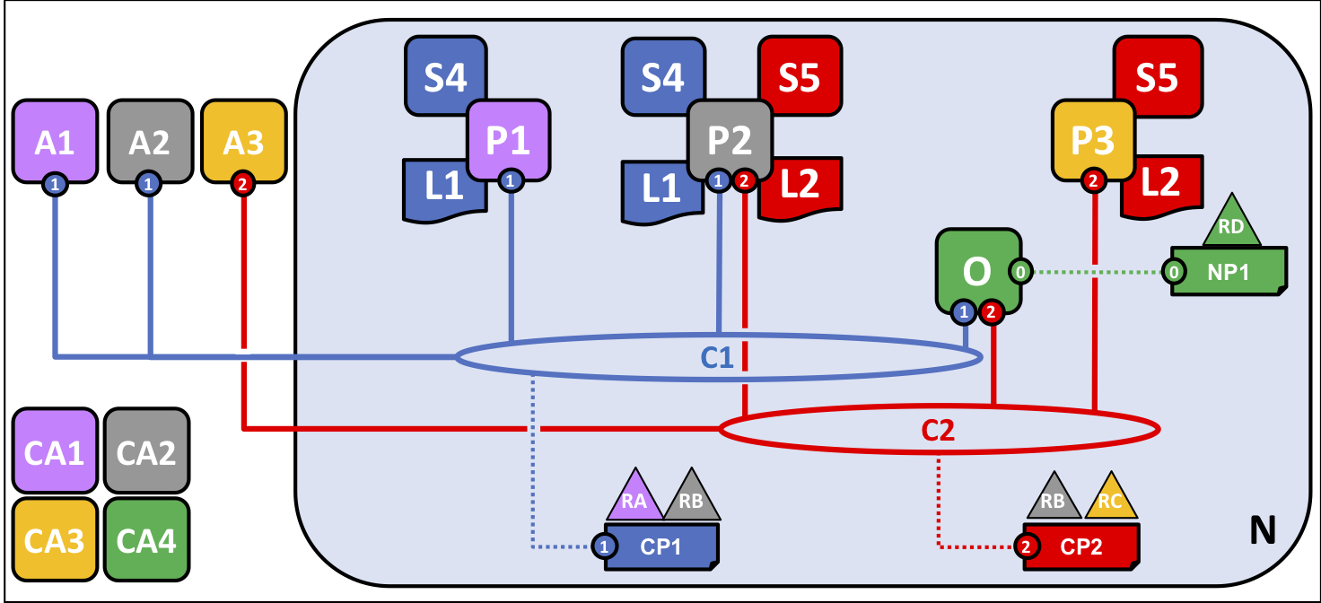

Peer-to-Peer Ledger
Hyperledger Fabric
A collection of small ledgers
Channels (C1, C2)
More rigid Tx distribution policy
Isolating transactions within the channels
Corda
Abstract logic view is a global graph of transaction
Most parties see a collection of small ledgers, shared with other business contacts
Notaries are used to further limit transaction distribution
Special agents
Attest to the integrity of unseen parts of the transaction graph
Notes:
LONG
Corda, the abstract logical view of transaction history is of a global graph of transactions.
the view that most parties see is a collection of small ledgers, each shared with their related business contacts.
transactions are only distributed to parties of interest
special agents (notaries) can be used to further limit the distribution of transactions while attesting to the integrity of unseen parts of the transaction graph.
Network comprising four organizations, represented by different colors
Jointly decided set up a hyperledger fabric network
R1 and R2 have a need for a private communications within the overall network through C1 , as do R2 and R3 through C2.
Peer node P1 maintains a copy of the ledger L1 associated with C1.
Peer node P2 maintains a copy of the ledger L1 associated with C1 and a copy of ledger L2 associated with C2.
Peer node P3 maintains a copy of the ledger L2 associated with C2.
Channel C1 is governed according to the policy rules specified in channel configuration CC1; the channel is under the control of organizations R1 and R2.
Channel C2 is governed according to the policy rules specified in channel configuration CC2; the channel is under the control of organizations R2 and R3.
There is an ordering service O4 that serves as a network administration point for N, and uses the system channel.

Slide 26
Taxonomy Dimensions
(De)centralization
Deployment
Ledger Structure
Consensus Protocol
Block Configuration and Data Structure
Auxiliary Blockchain
Anonymity
Incentive System
Notes:
8 dimensions to classify blockchain variants

Slide 27



Consensus Protocol
Miners generate new blocks
Miners propagate the blocks to the peers in the blockchain network
Miners may encounter different competing new blocks
Miners resolve this using consensus mechanism

Slide 28
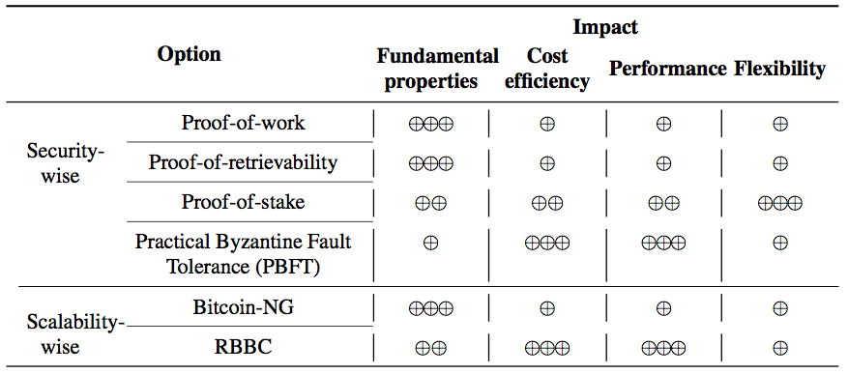
Tradeoff Overview
*
* By now, more options exist
Notes:
The choice of consensus protocol impacts security and scalability.
Usually the approach is fixed for a particular blockchain;
Hyperledger, as a framework with a modular architecture that caters for pluggable implementations of various consensus protocols.

Slide 29
Proof-of-Work 1/2
Nodes compete for right to create block
Solve a hash puzzle
Easy to verify, difficult to solve
Takes effectively random time, proportional to computational power
Nonce
H( ) of previous block
Transactions
⁞
H(nonce || H() of previous block || Tx || … || Tx) is very small
Output space of hash (256 bits)
00000…
Target space
If the Hash function is secure: the only way to succeed is to try enough number of values
Probability(wining next block) = fraction of global hash power the miner controls
Notes:
LONG
Bitcoin miners compete for the right to create block.
To create block, miner needs to solve a hash puzzle.
Find a nonce that make the hash of the concatenation of the strings a very small value starts with a list of 0
One directional function, easy to verify and difficult to solve.
The only way is to try large enough number of nounce until you get lucky
The probability to win the write permission is proportional to the fraction of global hash power the miner control
Difficulty is adjustable by changing the number of 0s

Slide 30

Proof-of-Work 2/2
Not energy-efficient
Electricity consumption of Bitcoin is close to Turkmenistan
Proof-of-work for good use
Primecoin
Generates prime number chains which are of interest to mathematical research.
Notes:
The work done in PoW is put to good use
Primecoin generates prime number chains which are of interest to mathematical research

Slide 31
Student Task
Imagine you were to run a mining pool with 100 computers (of similar power)
How would you organize the work of the machines?

Slide 32





Proof-of-Stake
Select the next mining node based on control of the native digital currency
Align the incentive of digital currency holders with the good operation
Does not necessarily select the next miner based on largest stakeholding
More Cost-efficient, shorter latency
Delegated Proof-of-Stake
Accounts delegate their stake to other accounts rather than participating in transaction validation
Bitshare
Representatives take turns in a round-robin manner
Peercoin
Prove the ownership of a certain amount of peercoin
Combines randomization and coin age
Notes:
Peercoin needs to prove the ownership of a certain amount of peercoin currency to mine blocks.
Tendermint used in Eris, and Casper for Ethereum.
Proof of stake does not necessarily select the next miner based on largest stakeholding,
Nxt also uses a random factor, and Peercoin combines randomisation and coin age.
Compared with proof of work, proof of stake is more cost-efficient because much less computational power is used in mining, and latency is also shorter. However, passive holding of assets may become harder.

Slide 33


Practical Byzantine Fault Tolerance (PBFT)
Ensures consensus despite arbitrary behavior from fraction of participants
More conventional approach within distributed systems
Stronger consistency and lower latency
Smaller number of participants
Used in permissioned blockchains
All participants agree on the list of participants / the network
Notes:
The Practical Byzantine Fault Tolerance (PBFT) protocol has been applied for consensus in permissioned blockchains, e.g., in Stellar.

Slide 34
Other Alternatives
Proof-of-authority (PoA)
Recent consensus algorithms, Byzantine fault tolerant
Based on known set of block creators/validators (authorities)
New block created every x seconds (optionally only when needed)
Each block needs to be confirmed by majority of authorities
Two protocols available for Ethereum: Aura and Clique
Downside: known attack if some validators misbehave
Proof-of-retrievability (Permacoin)
In proportion to distributed storage of archival data
Proof-of-Elapsed time
Wait a random time to write the next block
Using Intel SGX
Run trusted code in trusted environment
Ensure the wait times are created fairly

Slide 35
Tradeoff Overview
Notes:
The choice of consensus protocol impacts security and scalability.

Slide 36
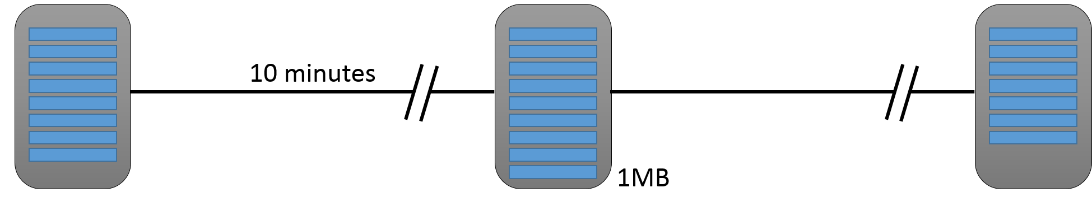
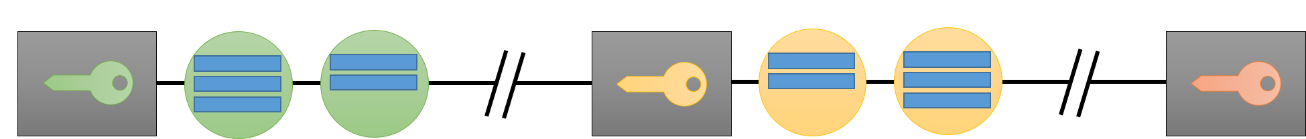
Scalability-wise
Bitcoin-NG
Decouple Bitcoin’s operation into two planes: Leader election and transaction serialisation
Selected leader is entitled to serialize transactions until the next leader is selected
Red Belly Blockchain
Democratic Byzantine consensus without leader nodes
Transactions being collected by a set of proposers
These nodes collectively decide on a proposed set of transaction to send to a verifier
Verifier enforces consensus using hashes exchanged for the proposed sets of transactions
^{Bitcoin}
^{Bitcoin-NG}
Notes:
LONG
The leader election in Bitcoin-NG is forward-looking, and ensures that the system is able to continually process transactions.
In between blocks, the traditional Bitcoin system appears idle, as miners are working to discover the next block
in Bitcoin-NG, the key-blocks can be tiny because they need contain only the coinbase transaction, which names the public key that the miner will be using to sign microblocks.
Following the key-block, the lead miner can quickly issue microblocks, simply by signing them with the private key corresponding to the public key named in the key-block’s coinbase.
Microblock creation is limited solely by signing speed (in the millisecond range) and network propagation speeds of small microblocks.
RBBC uses a kind of democratic Byzantine consensus approach in not requiring leader nodes.
Verifiers enforce consensus using hashes exchanged for the proposed sets of transactions.

Slide 37
Taxonomy, Part 1
Source of most materials:
Xiwei Xu, Ingo Weber, and Mark Staples. Architecture for Blockchain Applications. Springer, 2019

